Slide 1
Climate Data Analytics Platform
EProject

Slide 2
Student Information
Student ID | Student Name | Contribution of Work
Student1420981 | Muhammad Saad Karim | 100%
Student1421220 | Tayyaba | 100%
Student1368985 | Mahnoor | 0%
Student1418404 | Laraib | 0%
Student1335767 | Lamia Raza | 0%
Student1418410 | Albina | 0%

Slide 3
Project Specification
Scope & Features (End-to-End):
Authentication & Authorization → Secure login with JWT + RBAC (Admin / Analyst)
Data Ingestion → Upload CSV, fetch Weather API, Satellite Imagery integration
Data Storage → MongoDB Atlas + Local dataset storage (scalable & fault-tolerant)
Data Processing → Aggregations, grouping, averages, pattern detection
Real-Time Data Processing → SSE streams, live dataset charts, city temperature updates
Machine Learning Models →
Anomaly Detection (Isolation Forest)
Forecasting (ARIMA)
Correlation Analysis (Auto, Cross, Matrix)
Weather Services → Live weather details & chatbot assistant (OpenWeather API)
Admin Management → Manage admin users (CRUD)
Feedback System → Submit, track, update, and resolve feedback
Outcome: A full-stack platform enabling climate agencies to ingest, analyze, predict, and visualize climate data in real time with secure access control.

Slide 4
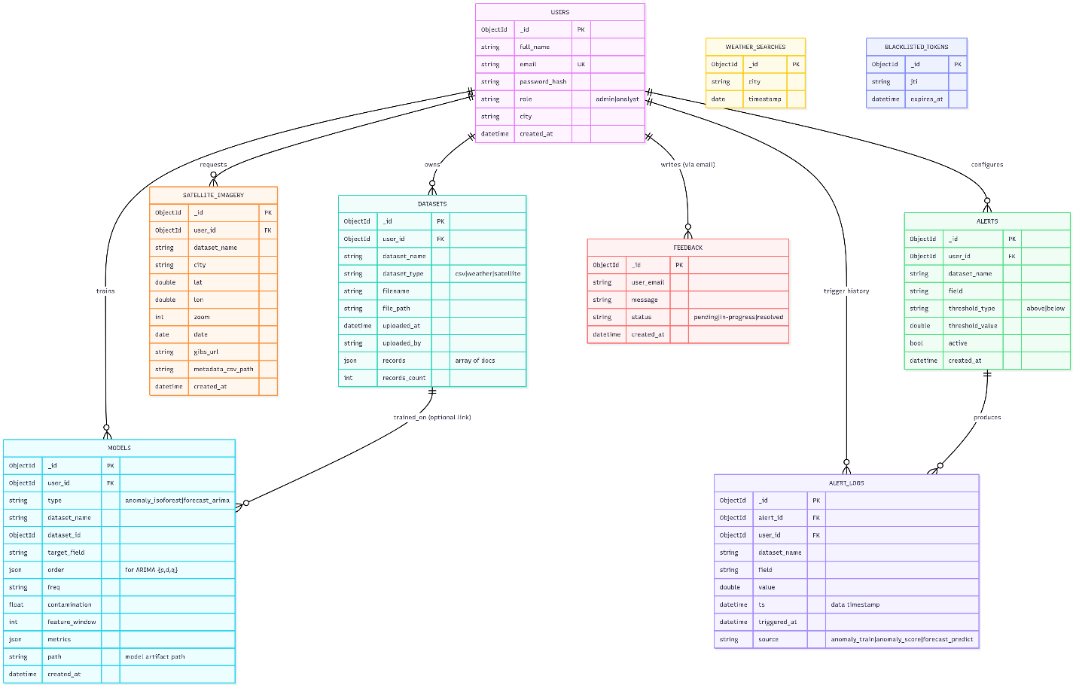
ERD (Entity Relationship Diagram)

Slide 5
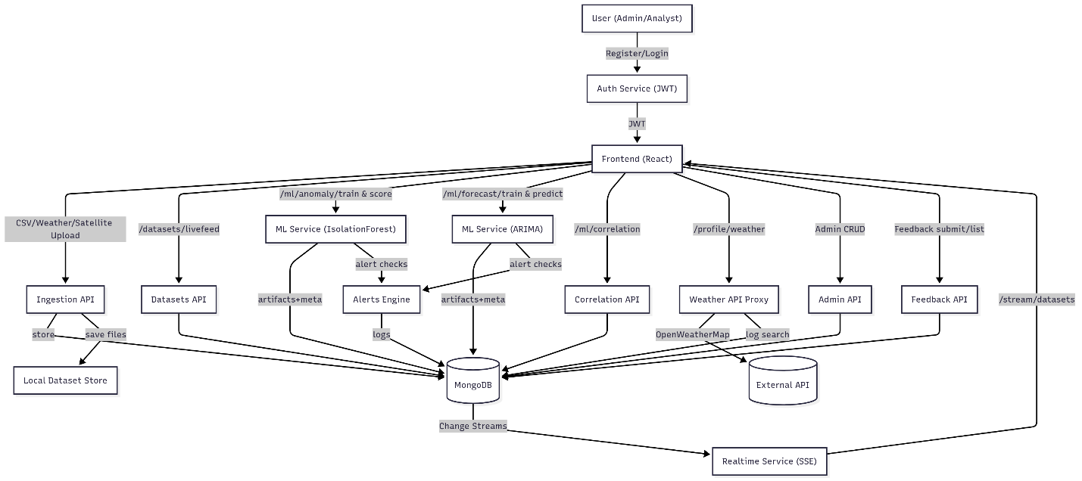
System Flow

Slide 6
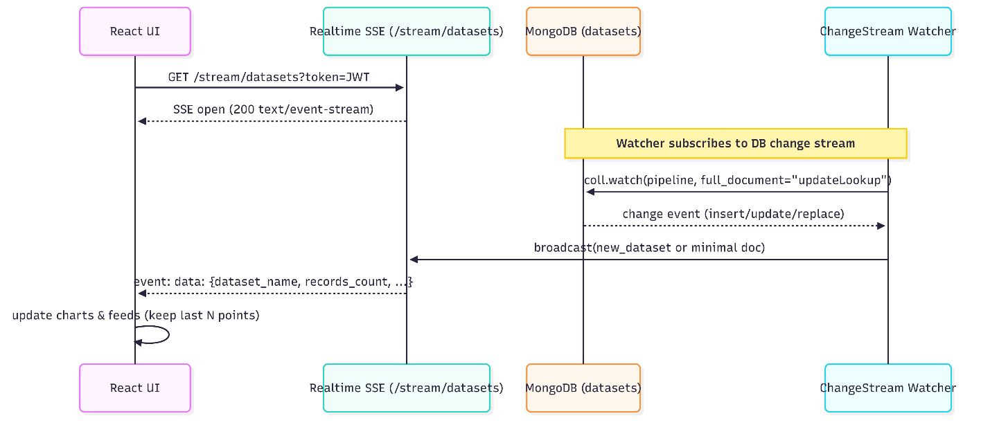
Real-Time SSE Sequence

Slide 7
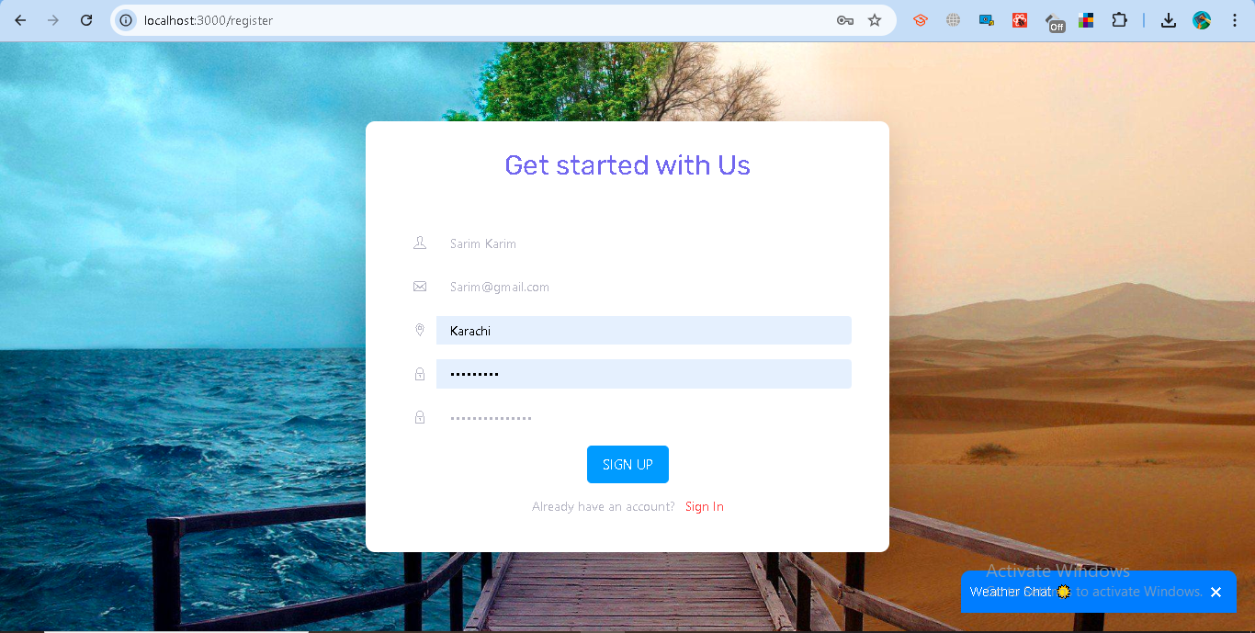
Authentication & Authorization
Notes:
Purpose
Secure login & role-based access control (RBAC).
Distinguish between Admin and Analyst (User).
Protects data, models, alerts, and feedback modules.
Key Features
Registration (Analyst only)
Enter Full Name, Email, Password, City.
Passwords hashed (bcrypt).
Default role = Analyst.
Login
Validate credentials.
Issues JWT with:
user_id
email
role (admin / analyst)
exp (2 hours).
Access Control
Analyst: Profile, datasets, anomaly/forecast models, feedback.
Admin: Full control → manage users, datasets, alerts, feedback.
Logout
Token blacklisted.
Response: Logged out successfully.
Error Handling
400 → Missing fields.
401 → Invalid/expired token.
403 → Forbidden (role mismatch).

Slide 8
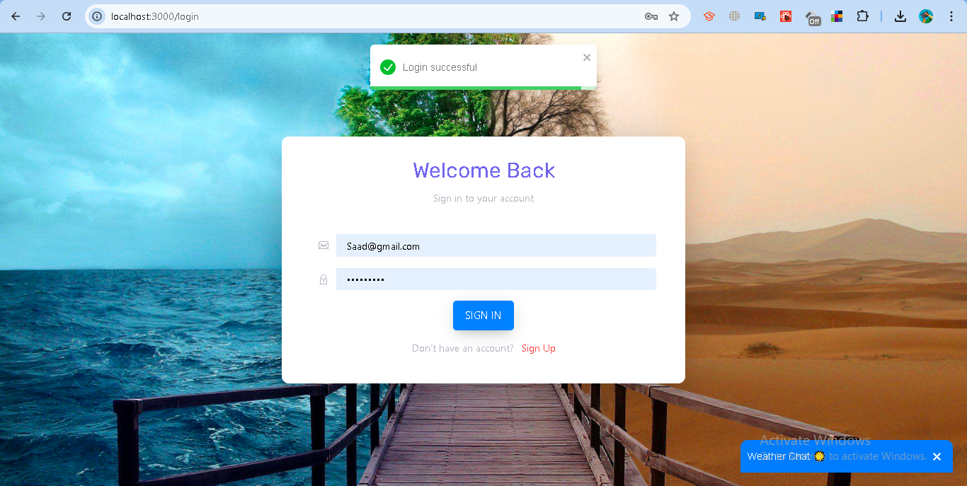
Authentication & Authorization
Notes:
Purpose
Secure login & role-based access control (RBAC).
Distinguish between Admin and Analyst (User).
Protects data, models, alerts, and feedback modules.
Key Features
Registration (Analyst only)
Enter Full Name, Email, Password, City.
Passwords hashed (bcrypt).
Default role = Analyst.
Login
Validate credentials.
Issues JWT with:
user_id
email
role (admin / analyst)
exp (2 hours).
Access Control
Analyst: Profile, datasets, anomaly/forecast models, feedback.
Admin: Full control → manage users, datasets, alerts, feedback.
Logout
Token blacklisted.
Response: Logged out successfully.
Error Handling
400 → Missing fields.
401 → Invalid/expired token.
403 → Forbidden (role mismatch).

Slide 9
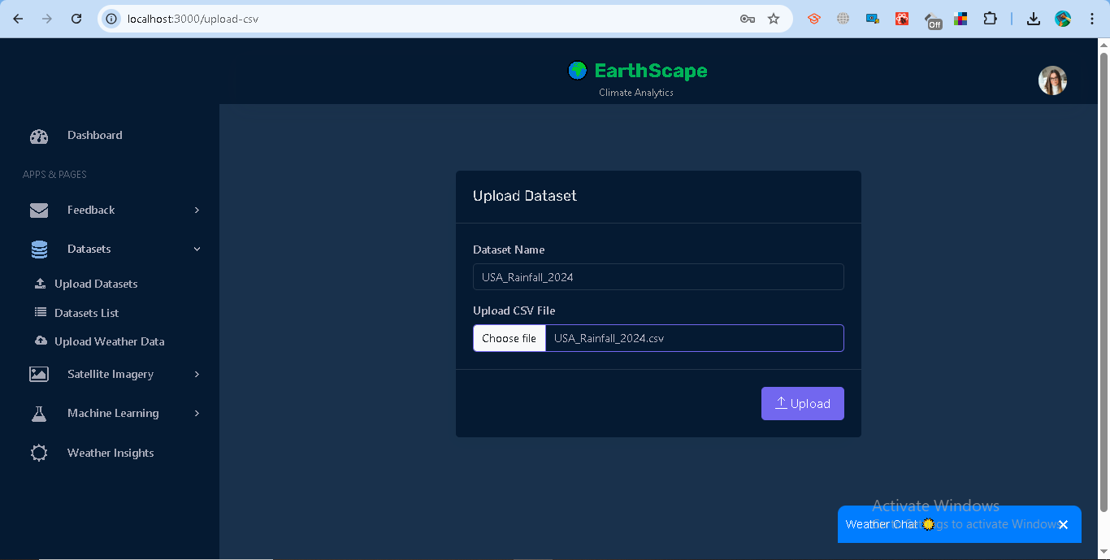
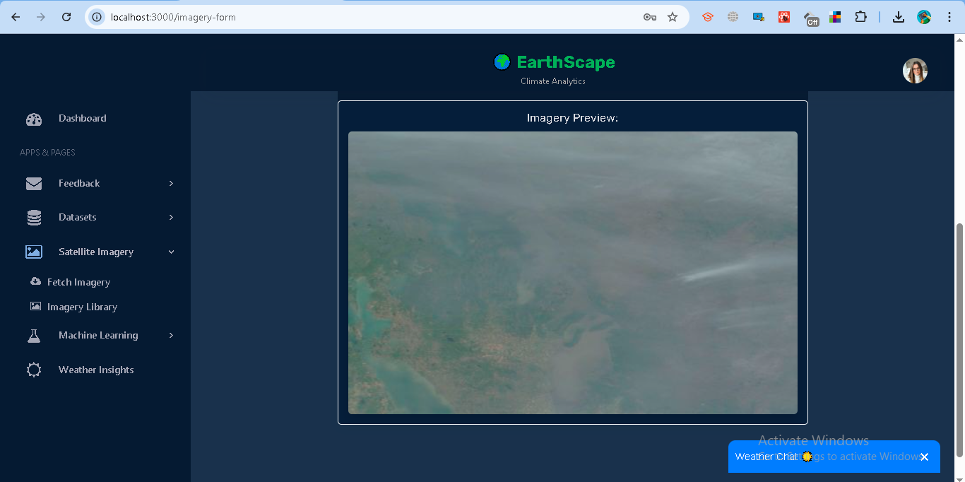
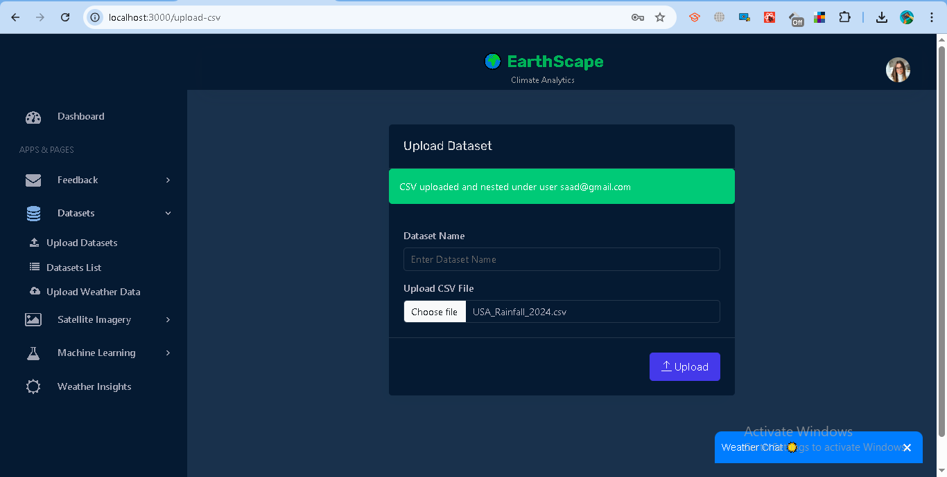
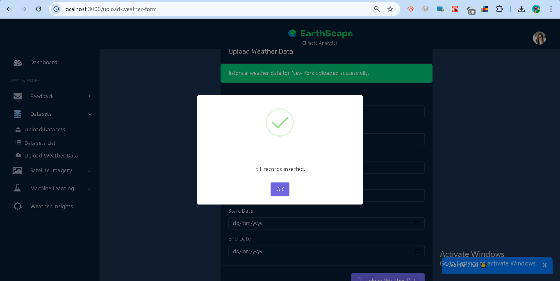
Data Ingestion
Notes:
Purpose
Bring climate data into the platform for analysis (historical and near-real time).
Standardize storage in MongoDB and local /dataset file store.
Supported Types
CSV files (user uploads).
Satellite imagery metadata (NASA GIBS).
Historical weather records (Meteostat).
A) CSV Upload
Path: Dataset → Upload Dataset → CSV
Inputs: Dataset Name, .csv file
System: validate → persist records → link file path
Output: “CSV uploaded and nested under user [email]” + record count
B) Satellite Imagery
Path: Satellite Imagery → Fetch Imagery
Inputs: Dataset Name, City, Lat/Lon, Zoom, Date (optional)
System: convert to WMTS tiles → fetch GIBS preview → save metadata + CSV
Output: imagery entry with location, date, zoom, preview URL
C) Weather Data (Historical)
Path: Dataset → Upload Weather Data
Inputs: Dataset Name, City, Start Date, End Date
System: query Meteostat → normalize fields (temp, humidity, wind, precip, pressure) → save CSV
Output: downloadable dataset CSV
Dataset Management
View: Dataset → Datasets list (most recent first)
Download: direct CSV link per dataset
Delete: users delete their own; admins can delete all
Access Control
Analyst: ingest and manage own datasets only
Admin: full visibility and management across users
Error Handling
400: invalid/missing inputs or unsupported file
401: missing/expired token
404: city/source not found
500: external API failure or parse error

Slide 10
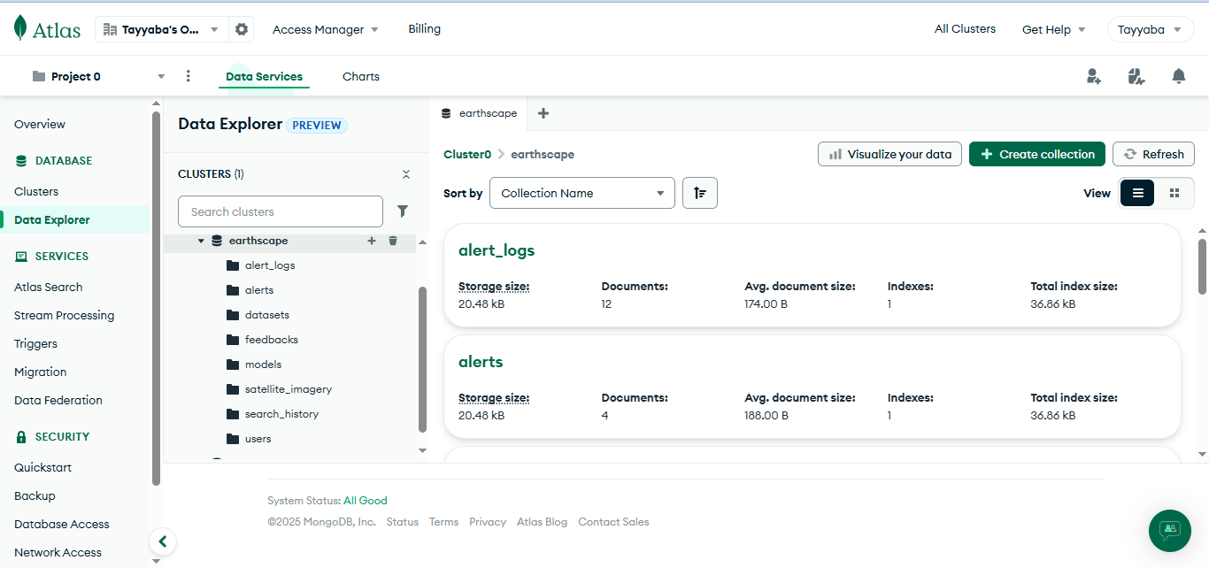
Data Storage
Notes:
Implementation
MongoDB Atlas (document-oriented, scalable, fault-tolerant).
Designed for flexibility → CSVs, satellite metadata, weather records.
Local /dataset/ folder → actual CSV/imagery files, referenced in DB.
Collections
Users → credentials, roles, city (for weather API).
Datasets → uploaded CSV + metadata (filename, path, uploader, records).
Satellite_Imagery → lat/lon, zoom, GIBS URL, generated CSV.
Models → anomaly & forecast models (IsolationForest / ARIMA).
Alerts & Logs → thresholds + triggered events.
Feedback → messages, status, timestamps.
Optimization Strategies
Indexing: user_id, dataset_name, filenames → fast queries.
Partitioning / Sharding: horizontal scaling for large datasets.
Document Nesting: datasets grouped under each user doc.
File Storage: CSVs stored locally, paths referenced in MongoDB.

Slide 11
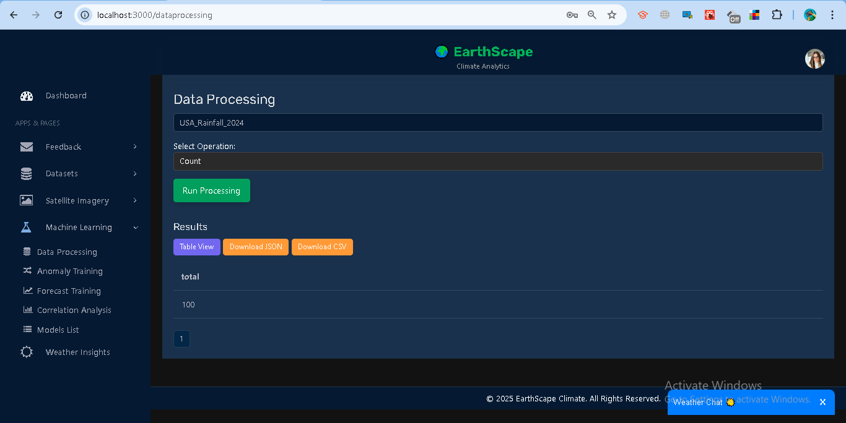
Data Processing
Notes:
Purpose
Analyze climate datasets (CSV, Weather, Satellite) stored in MongoDB.
Provide quick insights: counts, averages, groupings, temporal patterns.
Available Operations
Count → total records.
Average → mean of a numeric field (e.g., temperature).
Group By → cluster records (e.g., by city, by bins).
Pattern Detection → seasonality, monthly/temporal grouping.
How to Use (UI)
Navigate to Machine Learning → Data Processing.
Select a dataset.
Choose an operation (Count / Average / Group By / Pattern).
Run Processing.
View results as Table or Chart (Bar/Line).
Optionally download as CSV/JSON.
Examples
Count → { total: 1000 }
Average temperature → { average: 17.42 }
Group by city → [ { _id: "New York", count: 123 }, ... ]
Pattern on datetime → monthly counts { _id: 1, count: 34 }
Error Handling
400 → Invalid field or missing dataset.
401 → Unauthorized (invalid/expired token).
500 → Data type mismatch or query error.

Slide 12
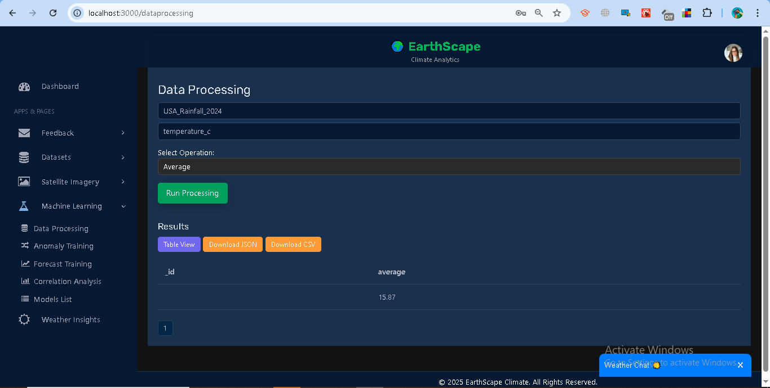
Data Processing
Notes:
Purpose
Analyze climate datasets (CSV, Weather, Satellite) stored in MongoDB.
Provide quick insights: counts, averages, groupings, temporal patterns.
Available Operations
Count → total records.
Average → mean of a numeric field (e.g., temperature).
Group By → cluster records (e.g., by city, by bins).
Pattern Detection → seasonality, monthly/temporal grouping.
How to Use (UI)
Navigate to Machine Learning → Data Processing.
Select a dataset.
Choose an operation (Count / Average / Group By / Pattern).
Run Processing.
View results as Table or Chart (Bar/Line).
Optionally download as CSV/JSON.
Examples
Count → { total: 1000 }
Average temperature → { average: 17.42 }
Group by city → [ { _id: "New York", count: 123 }, ... ]
Pattern on datetime → monthly counts { _id: 1, count: 34 }
Error Handling
400 → Invalid field or missing dataset.
401 → Unauthorized (invalid/expired token).
500 → Data type mismatch or query error.

Slide 13
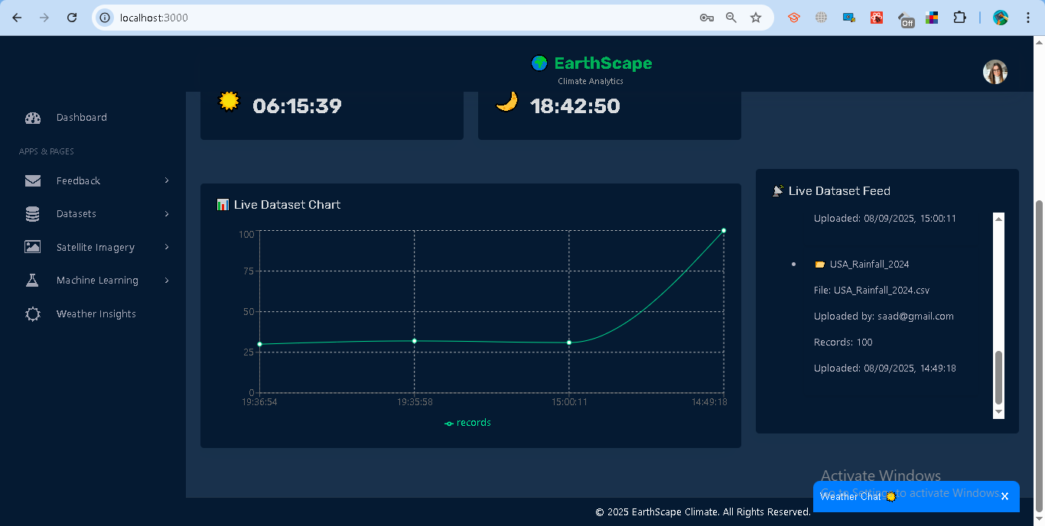
Real-time Data Processing
Notes:
Purpose
Integrate real-time streaming with batch datasets.
Allow live monitoring of dataset uploads and temperature records without page refresh.
Steps
Live Dataset Chart
Shows records added over time.
Loads historical data via /datasets/livefeed.
Subscribes to SSE /stream/datasets for new updates.
Live Dataset Feed
Lists latest 10 datasets.
Displays file name, uploader, record count, timestamp.
Option to expand → preview sample records.
Live Temperature (per City)
Plots temperature trends for multiple cities.
Loads recent records via /datasets/latest.
Subscribes to updates via SSE /stream/datasets.
Cities selectable from dropdown.
Access Control
Analyst → see only their datasets.
Admin → full visibility across all datasets.
Error Handling
401 → Unauthorized (invalid/expired token).
404 → No datasets found.
SSE connection lost → "Reconnect or check token".

Slide 14
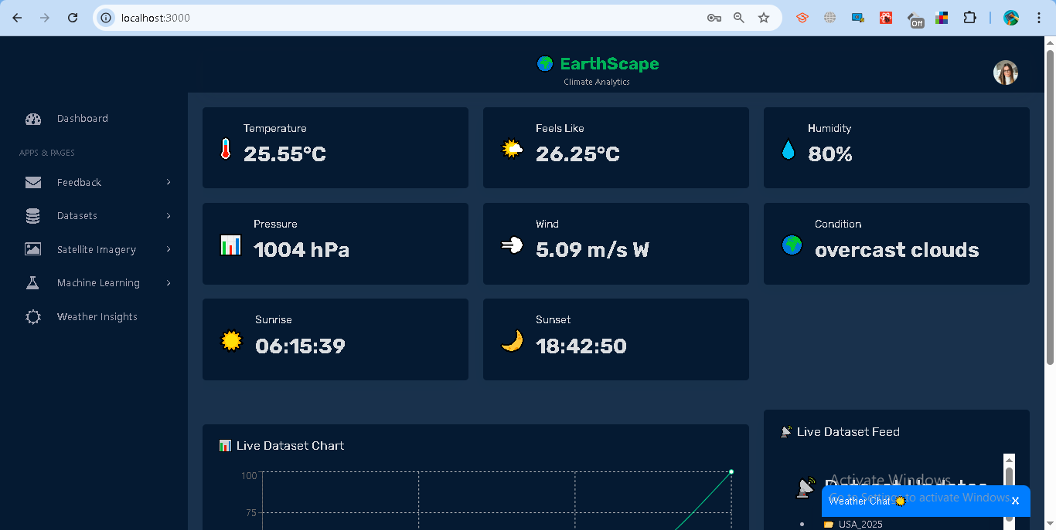
Real-time Data Processing
Notes:
Purpose
Integrate real-time streaming with batch datasets.
Allow live monitoring of dataset uploads and temperature records without page refresh.
Steps
Live Dataset Chart
Shows records added over time.
Loads historical data via /datasets/livefeed.
Subscribes to SSE /stream/datasets for new updates.
Live Dataset Feed
Lists latest 10 datasets.
Displays file name, uploader, record count, timestamp.
Option to expand → preview sample records.
Live Temperature (per City)
Plots temperature trends for multiple cities.
Loads recent records via /datasets/latest.
Subscribes to updates via SSE /stream/datasets.
Cities selectable from dropdown.
Access Control
Analyst → see only their datasets.
Admin → full visibility across all datasets.
Error Handling
401 → Unauthorized (invalid/expired token).
404 → No datasets found.
SSE connection lost → "Reconnect or check token".

Slide 15
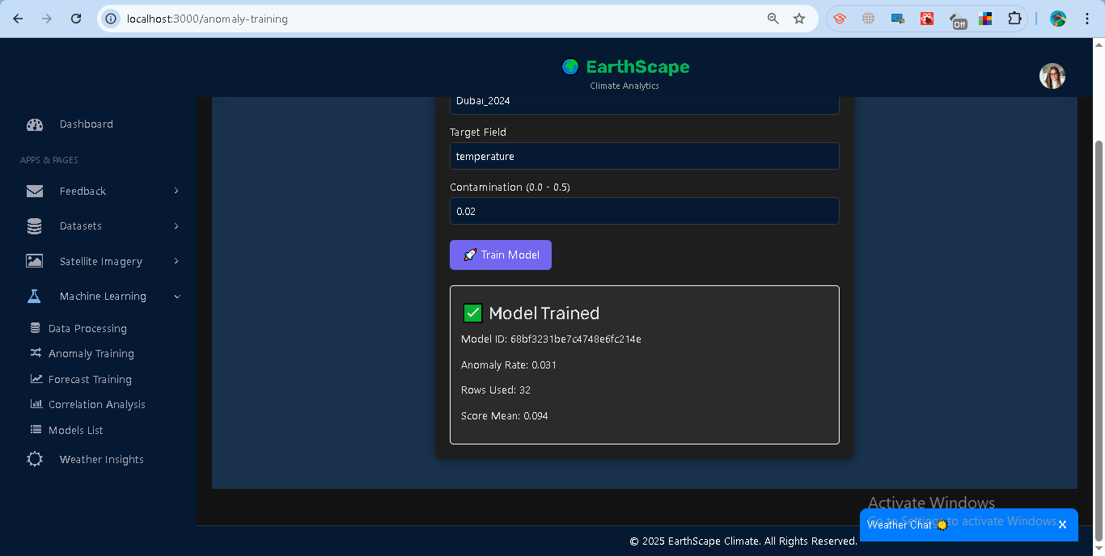
Machine Learning Models
Notes:
Purpose Apply ML to detect anomalies and forecast climate trends for actionable insights.
Models Integrated
Isolation Forest (Anomaly Detection)
Identifies unusual climate values (e.g., extreme temperature).
Inputs: Dataset + Target Field + Contamination Rate.
Outputs: Anomaly rate, score mean, rows used.
ARIMA (Forecasting)
Time-series prediction (temperature, humidity, etc.).
Auto-selects best (p,d,q) order via AIC.
Outputs: Predicted values, lower/upper bounds, frequency.
Workflow
Select Dataset → Target Field.
Train Model → Stored with ID + Metadata in MongoDB.
Predict / Score → Results displayed in charts & tables.
Alerts Engine → Threshold checks + log triggers.
Access Control
Analyst → Train/predict on own datasets.
Admin → Train/manage across all users.
Error Handling
400 → Invalid dataset/field or insufficient rows (<20).
401 → Unauthorized (token issue).
403 → Accessing another user’s model without admin rights.
500 → Model training/prediction failure.

Slide 16
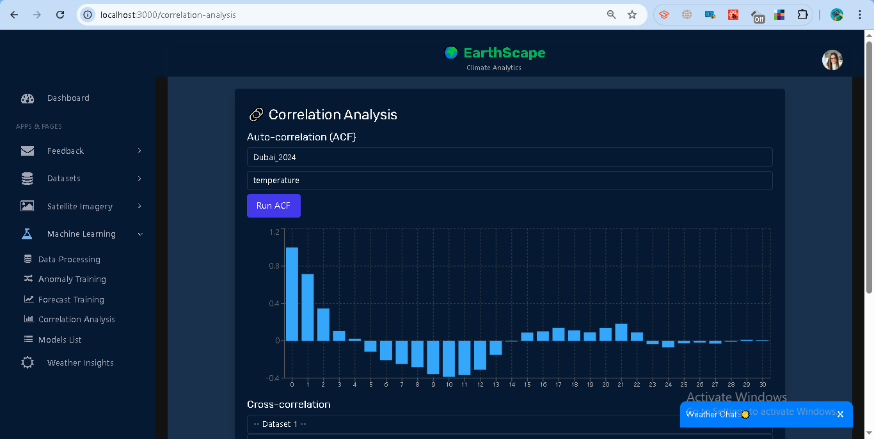
Machine Learning Models
Notes:
Purpose Apply ML to detect anomalies and forecast climate trends for actionable insights.
Models Integrated
Isolation Forest (Anomaly Detection)
Identifies unusual climate values (e.g., extreme temperature).
Inputs: Dataset + Target Field + Contamination Rate.
Outputs: Anomaly rate, score mean, rows used.
ARIMA (Forecasting)
Time-series prediction (temperature, humidity, etc.).
Auto-selects best (p,d,q) order via AIC.
Outputs: Predicted values, lower/upper bounds, frequency.
Workflow
Select Dataset → Target Field.
Train Model → Stored with ID + Metadata in MongoDB.
Predict / Score → Results displayed in charts & tables.
Alerts Engine → Threshold checks + log triggers.
Access Control
Analyst → Train/predict on own datasets.
Admin → Train/manage across all users.
Error Handling
400 → Invalid dataset/field or insufficient rows (<20).
401 → Unauthorized (token issue).
403 → Accessing another user’s model without admin rights.
500 → Model training/prediction failure.

Slide 17
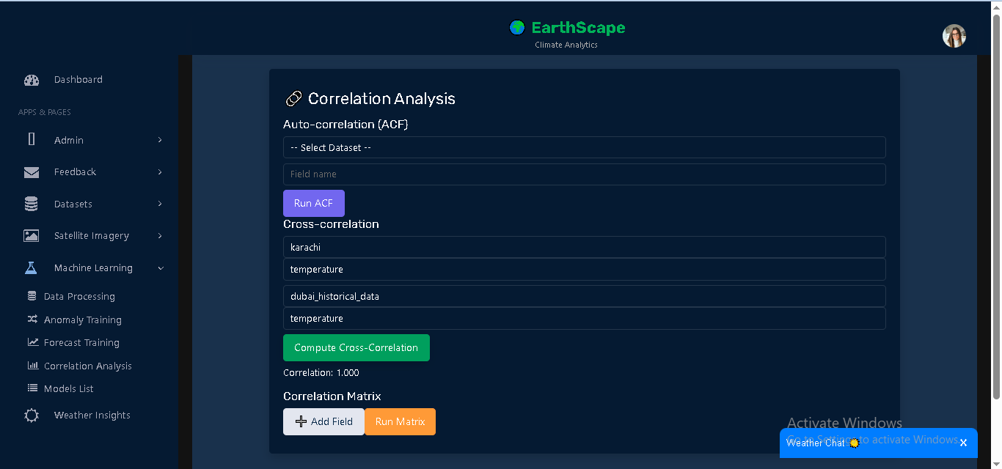
Machine Learning Models
Notes:
Purpose Apply ML to detect anomalies and forecast climate trends for actionable insights.
Models Integrated
Isolation Forest (Anomaly Detection)
Identifies unusual climate values (e.g., extreme temperature).
Inputs: Dataset + Target Field + Contamination Rate.
Outputs: Anomaly rate, score mean, rows used.
ARIMA (Forecasting)
Time-series prediction (temperature, humidity, etc.).
Auto-selects best (p,d,q) order via AIC.
Outputs: Predicted values, lower/upper bounds, frequency.
Workflow
Select Dataset → Target Field.
Train Model → Stored with ID + Metadata in MongoDB.
Predict / Score → Results displayed in charts & tables.
Alerts Engine → Threshold checks + log triggers.
Access Control
Analyst → Train/predict on own datasets.
Admin → Train/manage across all users.
Error Handling
400 → Invalid dataset/field or insufficient rows (<20).
401 → Unauthorized (token issue).
403 → Accessing another user’s model without admin rights.
500 → Model training/prediction failure.

Slide 18
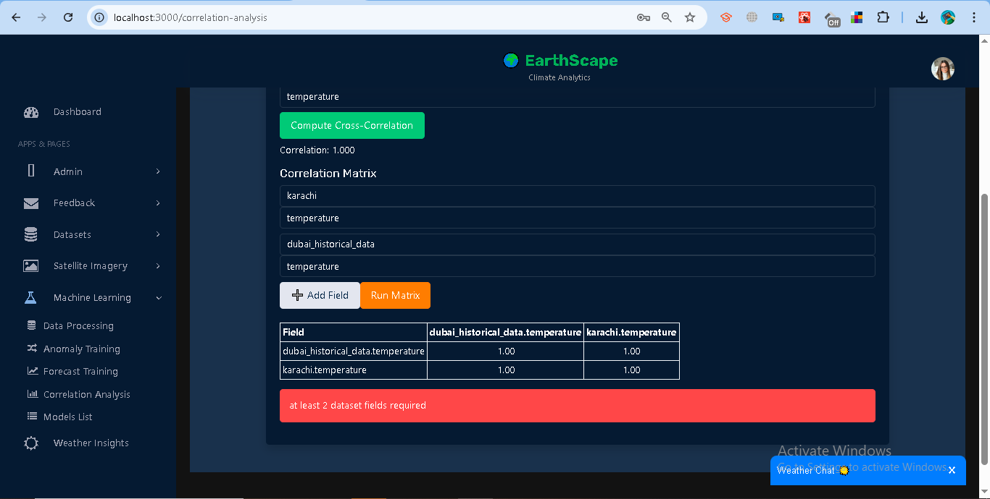
Machine Learning Models
Notes:
Purpose Apply ML to detect anomalies and forecast climate trends for actionable insights.
Models Integrated
Isolation Forest (Anomaly Detection)
Identifies unusual climate values (e.g., extreme temperature).
Inputs: Dataset + Target Field + Contamination Rate.
Outputs: Anomaly rate, score mean, rows used.
ARIMA (Forecasting)
Time-series prediction (temperature, humidity, etc.).
Auto-selects best (p,d,q) order via AIC.
Outputs: Predicted values, lower/upper bounds, frequency.
Workflow
Select Dataset → Target Field.
Train Model → Stored with ID + Metadata in MongoDB.
Predict / Score → Results displayed in charts & tables.
Alerts Engine → Threshold checks + log triggers.
Access Control
Analyst → Train/predict on own datasets.
Admin → Train/manage across all users.
Error Handling
400 → Invalid dataset/field or insufficient rows (<20).
401 → Unauthorized (token issue).
403 → Accessing another user’s model without admin rights.
500 → Model training/prediction failure.

Slide 19
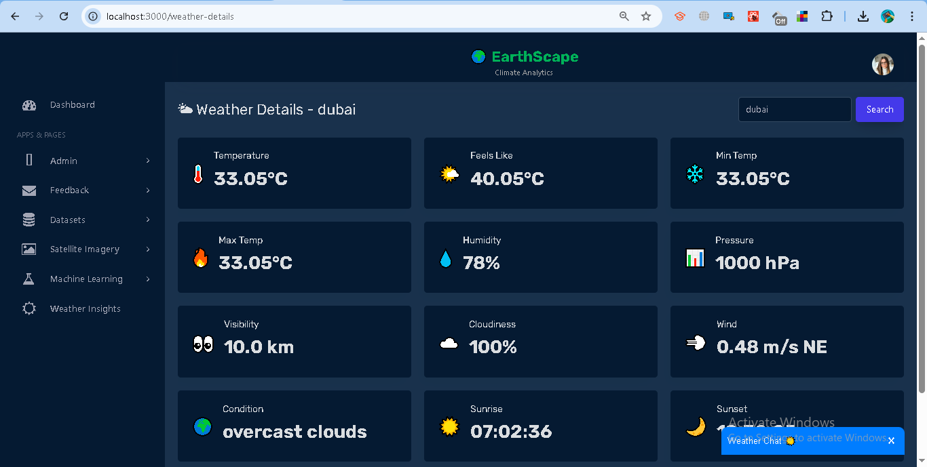
Weather Insights
Notes:
Purpose Provide real-time weather information for any city using OpenWeatherMap API.
Features
Search city → fetch live weather metrics.
Stored in MongoDB with timestamp (query history).
Dashboard-style cards:
Core: Temperature, Feels Like, Min, Max.
Atmosphere: Humidity, Pressure, Visibility, Cloudiness.
Wind & Condition: Wind speed/direction, Weather condition.
Sun Info: Sunrise & Sunset.
Rain/Snow: Displayed if available.
Access Control
Requires authentication (JWT).
Analyst → Can view weather for searched city.
Admin → Same as analyst, plus query logs available.
Error Handling
400 → No city provided.
404 → City not found.
500 → External API / server error.

Slide 20
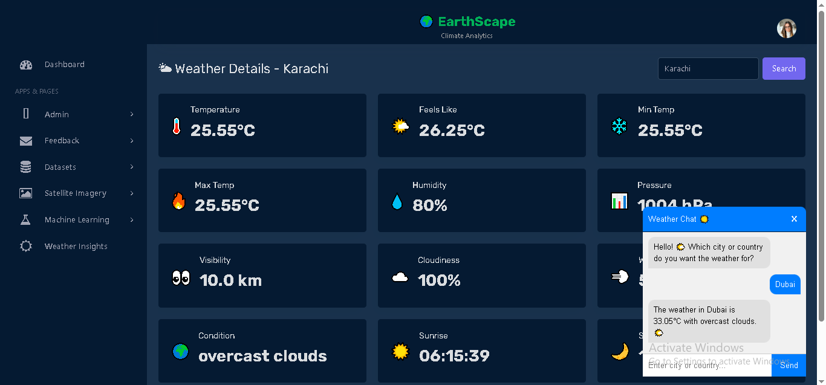
Weather ChatBot
Notes:
Purpose Interactive chat widget for real-time weather queries.
Features
Conversational interface.
Greets user → asks for city or country.
Queries backend weather API → responds with temp + description.
Auto-scroll + session persistence.
Example
User: “Dubai”
Bot: “The weather in Dubai is 33°C with clear sky ”
Error Handling
Invalid city → playful error response: “ Hmm... ‘X’ is not in our planet directory! Just Google it for the real country name ”
Access Control
Public → No login required.
API protected with OpenWeatherMap key.

Slide 21
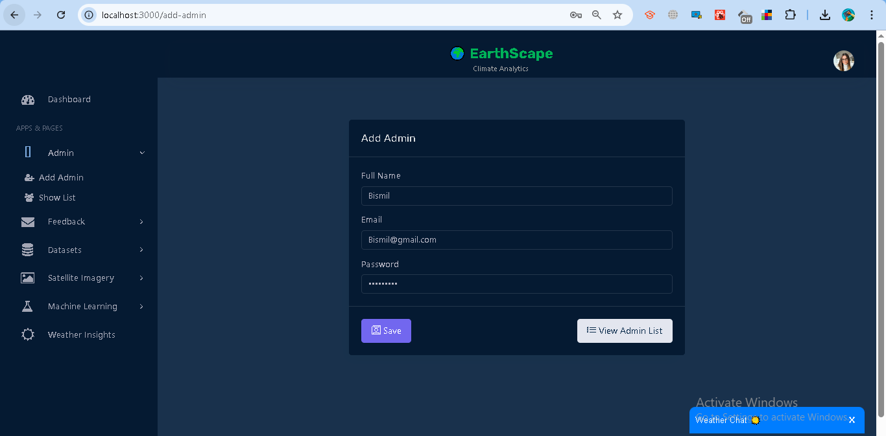
Admin Management
Notes:
Purpose Allow only admin users to manage administrator accounts.
Features
Add Admin → Enter Full Name, Email, Password.
Update Admin → Modify details of an existing admin.
Delete Admin → Remove admin accounts (with confirmation).
View Admin List → Display all admins with actions (edit/delete).
Access Control
Admins only → full rights.
Non-admins → Access Denied message + redirect to dashboard.
Error Handling
Missing fields → Prompt user to fill required inputs.
Unauthorized → User not logged in.
Forbidden → Only admins can access.
Server errors → Shown as error alerts.

Slide 22
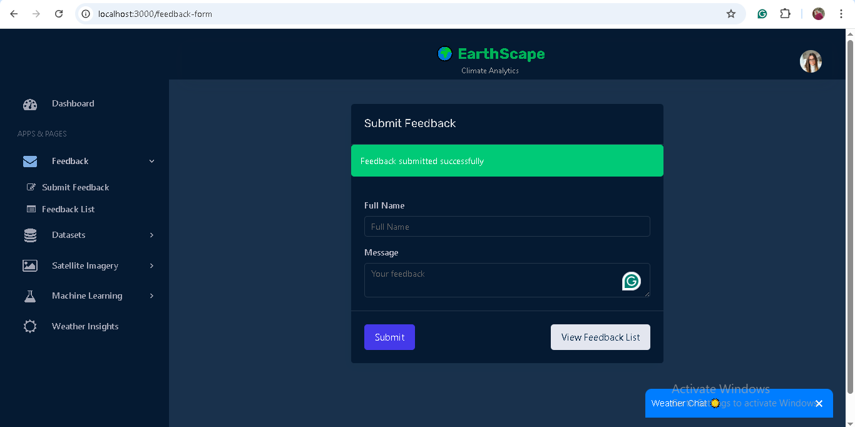
Feedback Management
Notes:
Purpose Provide a channel for analysts to submit feedback and allow admins to manage it.
Features
For Analysts (Normal Users):
Submit feedback (auto-linked with logged-in email).
View their own feedback list with status.
Status values: Pending, In-Progress, Resolved.
For Admins:
View all feedback from all users.
Update status (Pending → In-Progress/Resolved).
Delete feedback (with confirmation).
Access Control
Analyst → Limited to own feedback.
Admin → Full access.
Error Handling
Missing fields → Error prompt.
Unauthorized → Requires login.
Forbidden → Only admins can manage others’ feedback.
Invalid ID / Server errors → Displayed in alert.

Slide 23
Thank You

